Slide 1
Calorie Counting Website
By: Branden Bulatao, Isabel Sutedjo, Tiffany Pak, Sean Payba

Slide 2
Calorie Counting Website Description
Focusing on the design elements and user experience, the general purpose of this project is for users to have an enjoyable and easy experience while on their fitness journey. This tool allows user estimate their caloric needs based on their weight goals, log their foods that they have taken, and learn more ways to find a healthy lifestyle.
Notes:
sean

Slide 3
Targeted E - Easy to Learn
Focused on Easy to Learn aspect
Wanted to get users to learn more about the relationship of calories and their goals of losing, maintaining, or gaining weight
Any user with or without any experience of using a calorie counter will be able to easily interpret the results and gain knowledge regarding their diets
Experience should be easy, and at the same time informative

Slide 4
Measurement of Improvement - # of attempts made
For quantitative measurements, we measured the attempts made for calculating their calories
If the user makes more than 5 attempts to make a realistic calculation, then it indicated that the website is difficult to understand.
If the user made less attempts, then it indicated that they understood how the calculator is used.
Notes:
Branden
Quantitative Measurements
General time taken to get a calculation
Qualitative Measurements
Descriptive rating of how their experience went
Feedback about each page they navigated through
I.e. ‘What did you like/disliked about…?’

Slide 5
Target Population
College students, or anyone else who has trouble solidifying their fitness goals and don’t know where to start
Regular students
Student-athletes

Slide 6
Preliminary Industry Data
A significant number of college students gain weight during their college years. Almost 1 in 3 college American students have obesity presently (1). According to a survey in 2021, 44% of college students in the US described their weight as more than normal, i.e. either in the overweight or obese category

Slide 7


Persona
Name: Bradley
Age: 19
Occupation: Student
College student who goes to Stevens Institute of Technology
Started gaining weight after coming to college
Enjoys eating inside his dorm and uses meal swipes to bring food back to his dorm
Tends to order delivery from fast food places on Washington Street
Wants to turn his life around by losing weight and being more active
One day after Bradley grabbed some McDonald’s through delivery, his roommate challenged him to lose 15 pounds within 1 month. Bradley was feeling quite dubious, but he looked in the mirror and was not happy with what he saw. The challenge sparked something inside of him, and he decided that it was time to make a change in his life. He did not know where to start, so he turned to the “Calorie Counting” website to figure out how many calories he needed to cut per week. He registered an account and was able to see the calories that he needed to achieve his weight goal after logging his information. He was new to this, so the FAQ and additional examples helped him get started with his fitness journey.
1 month later: He has now become a gigachad and stays mewing.

Slide 8
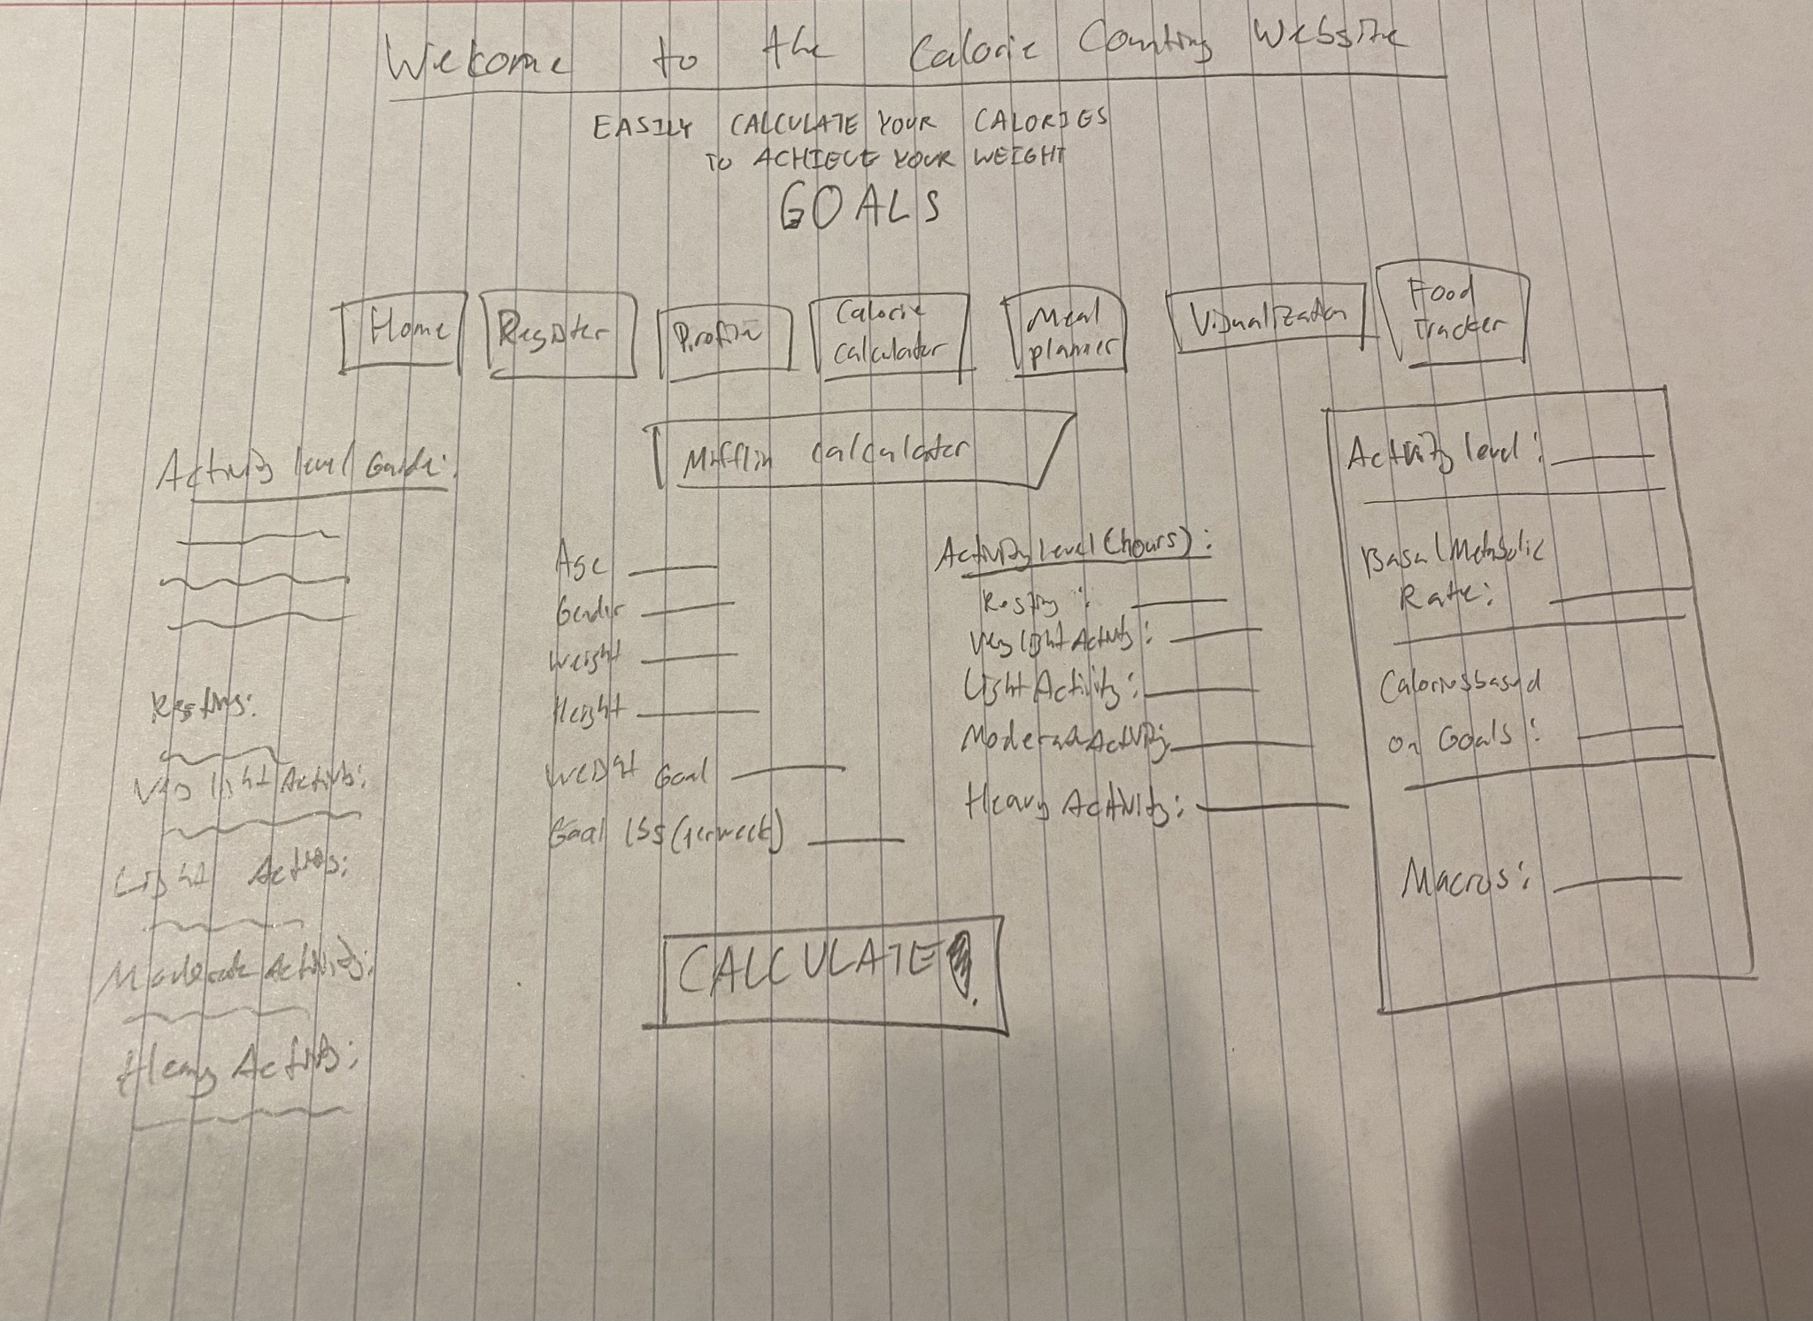
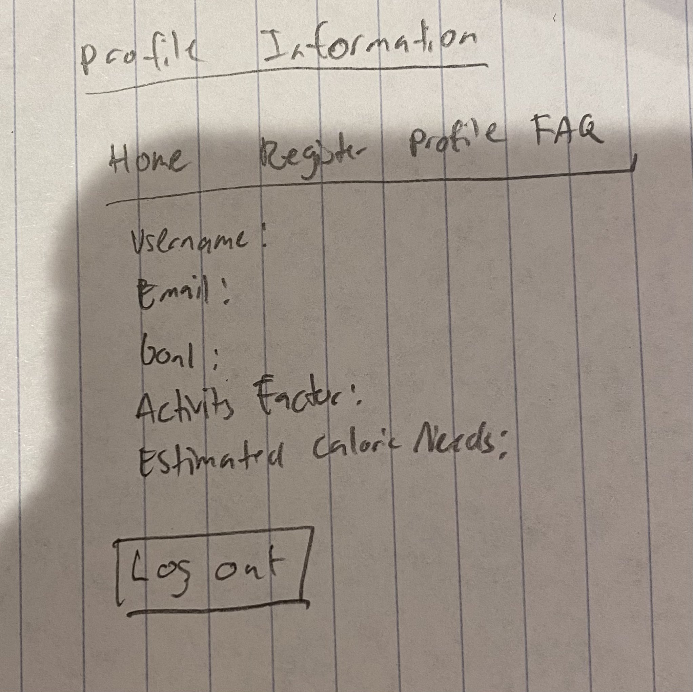
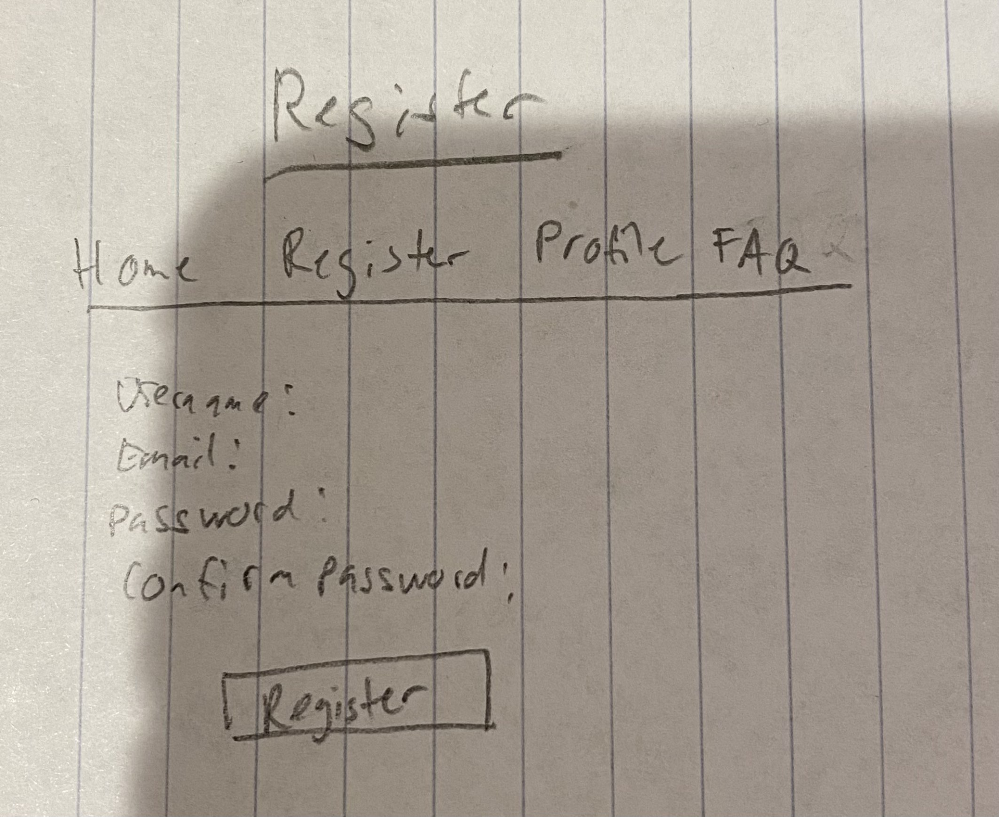
First Design (Paper Prototype)

Slide 9
User feedback - first design
Users unsure what should be buttons and what should not
Users find words seem cluttered, difficult to read
Too much text and an overwhelming amount of information
One person mentioned that there were too many links at the top which made it feel difficult to choose which links to go to as there were so many options
Number of users tested: 2
Notes:
isabel

Slide 10
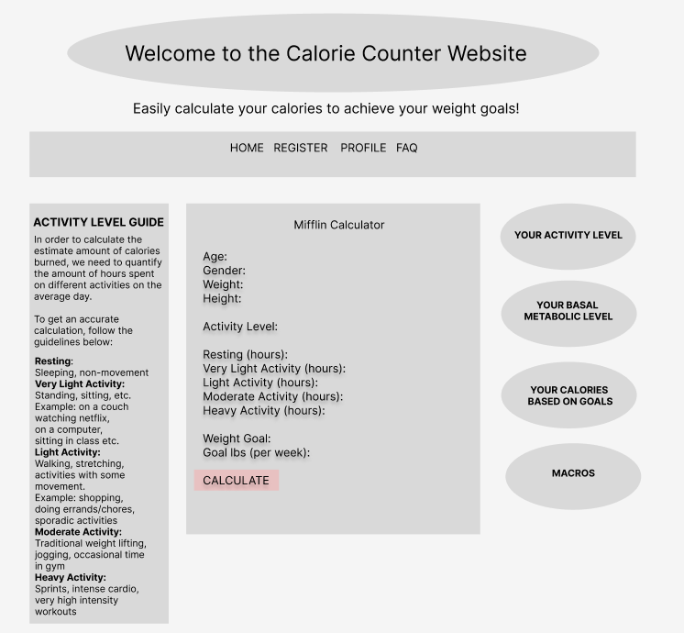
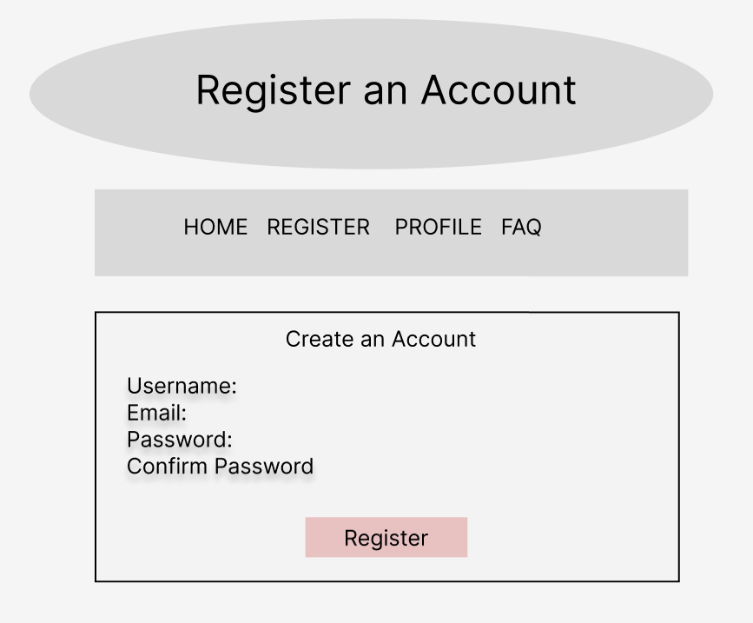
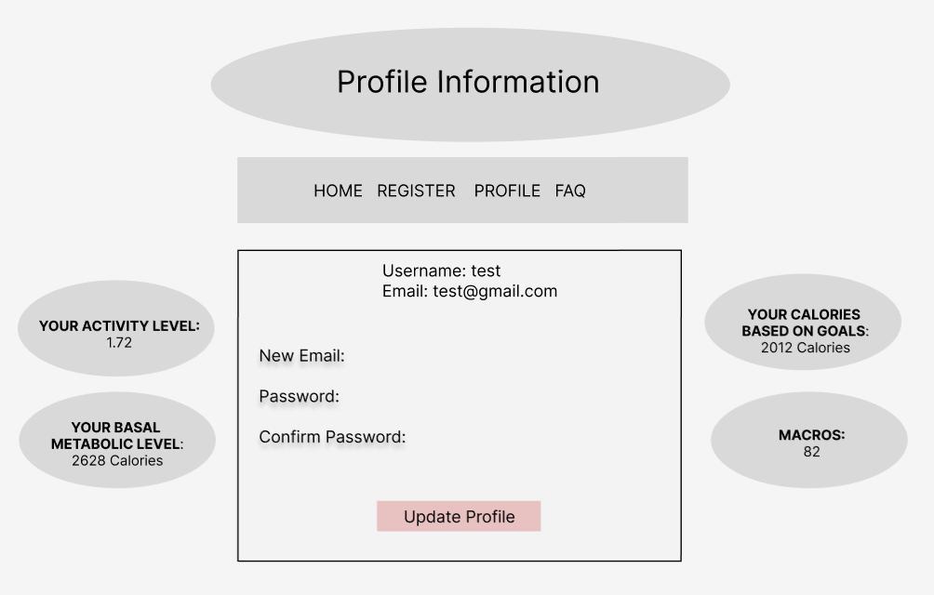

Second Design (medium fidelity)

Slide 11
User Feedback - Second design
Users liked the change to remove some links at the top and the new layout of the calculator with everything vertically instead of 2 separate columns
The changes between oval and rectangular buttons and layout felt confusing
A User suggested to make everything either rectangles or circles but not both
Information dump
Particularly on the Home pages
Users did not like the information in the profile to be split up on the left and right sides of the rectangle with the user’s profile information they thought it was distracting and out of place
Number of users tested: 2
Notes:
isabel

Slide 12
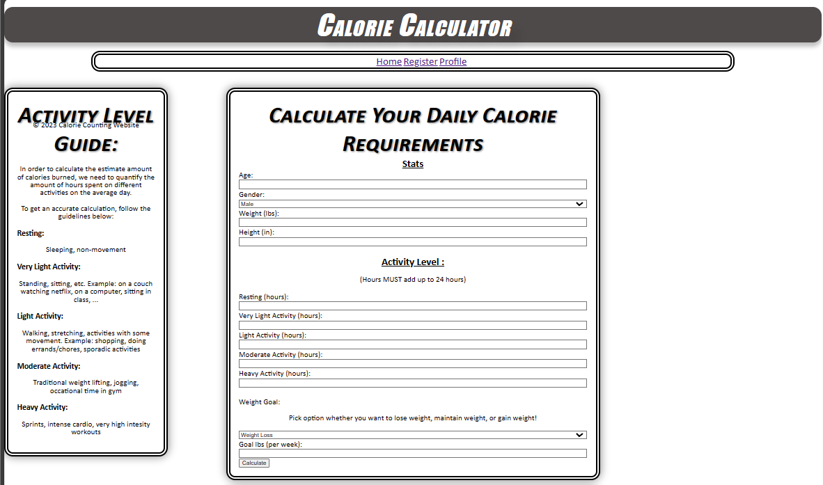
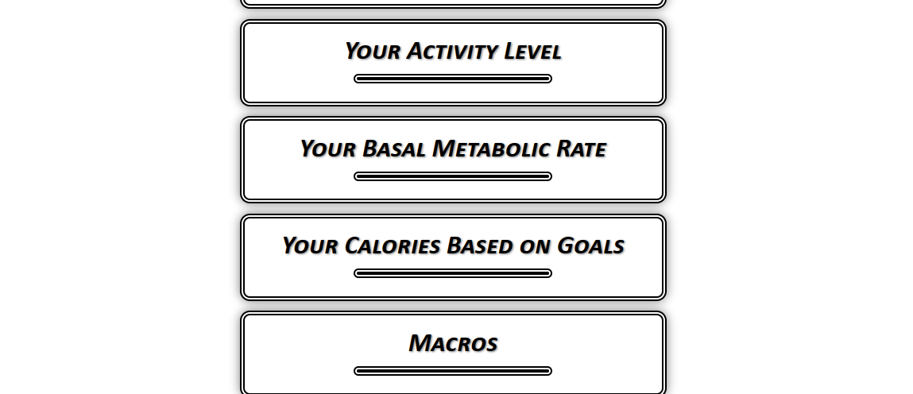
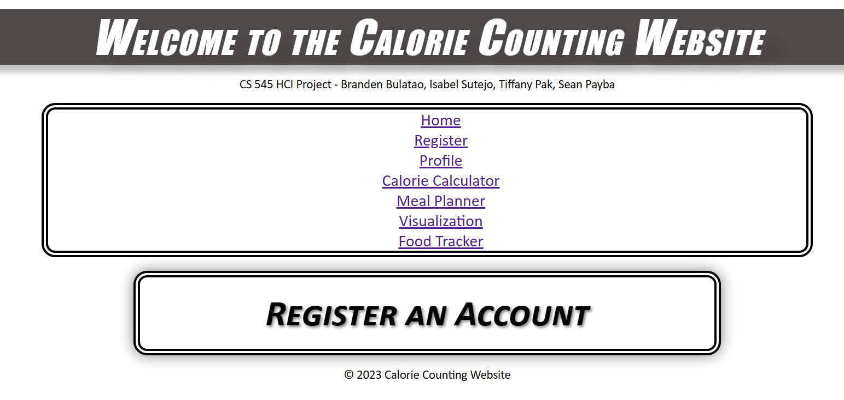
Third Design - (1st iteration of high fidelity)
Calculator page of the website. (right)
The home page (below)
Notes:
Branden (add screenshots)

Slide 13
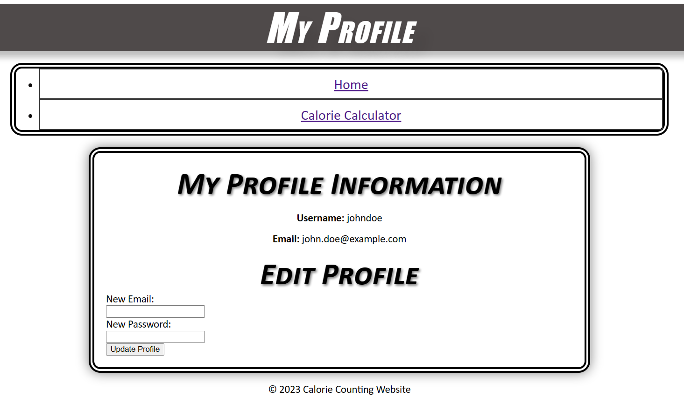
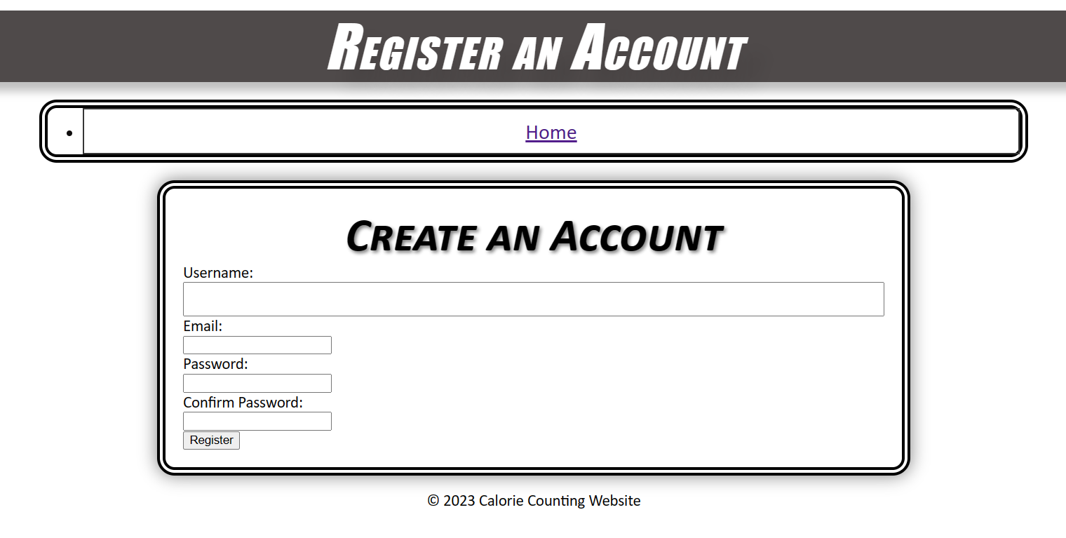
Notes:
Branden (add screenshots)

Slide 14
User Feedback - Third Design
Users appreciated variety of buttons and inputs
Users were able to understand the appeal of the website
Users enjoyed the concept of the calculator
Users commented on the simplicity of the page
Users liked the minimalistic design
Users found navigation confusing.
Nothing screamed to the user why this application is important to them.
Users found difficulty understanding what the inputs mean (activity factor inputs)
One user noted that they felt lost in the home page, since it did not bring them to the calculator first.
Users were able to break the calculator and make unrealistic results
Lack of boundaries with the calculator inputs
Negative numbers accepted
For activity factor: hours did not have to add up to 24, yet the calculator calculated it.
Observed that other pages (meal planner, visualization, food tracker) were not visited
Average # of attempts made until realistic result: 4.75
Number of users tested: 5
Notes:
Tiff (from doc)
The website confused users about what this website was about, as there was nothing to grab the user's attention. Nothing was screaming to the user, “Why do you need this application in your life?”. The calculator was confusing because nothing was explained about what the ‘activity factor’ was. There was a lack of input boundaries that “broke” the calculator (very unrealistic Calorie goals). It seems that they were also confused due to how many things were on the screen.
Fixes:
Moved the calculator to the home page
Added explanation to the ‘activity factor’ to calculate calories
Added FAQ for users to look at

Slide 15
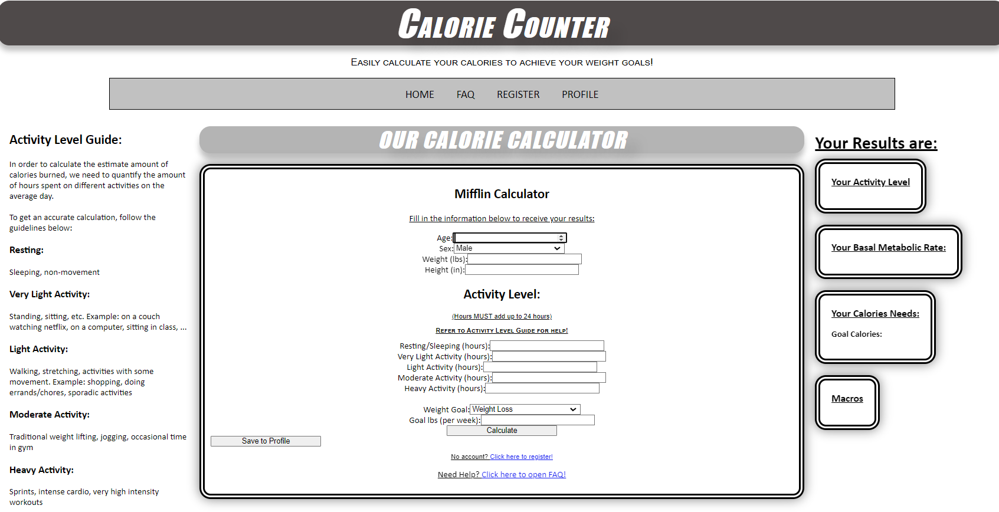
Fourth Design (2nd iteration of High Fidelity)
Design Improvements:
Moved Calculator to the home page
Added more explanations about the activity factor
Added FAQ for further explanations and background about how the calculator works.
Removed unused/unnecessary pages
Notes:
Branden (add screenshots)

Slide 16
User Feedback - Fourth Design
Users found guides about activity factor helpful.
Users commented how interactive the calculator is
Users noted that navigation is easy
Users find that the website is concise
Users disliked the lack of error considerations
FAQ page feels blank. There is no appeal.
Answers don’t visually pop out.
Users did not find the registration useful, nor did they find the profile page to be of a significance
Guidance only helped so much. Subject did not understand what each activity factor input meant.
Average # of attempts until realistic answer: 2.5
Number of users tested on this iteration: 5
Note: 3 users were the same from previous iteration
Notes:
Tiff (from doc)
The activity level guide was very helpful. It could be enhanced if there was more guidance on the top and guidance about the results. What do these results mean? What value do they have? FAQ was nice, the format was easy to read and concise. Not extremely wordy. Imagery isn’t necessary. However, the FAQ feels blank. The answers don’t pop up to your eyes and have room to be more visually appealing. Registering a profile was rough. At the current iteration, there was really no point to registering the profile because it provided the user almost nothing.
(NOTE: FAQ questions should have a dropdown and hover visualization, then there should be an animation of a drop-down box of the answer).

Slide 17
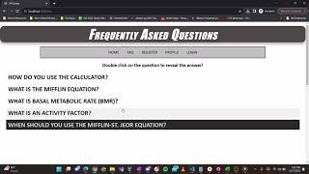
Final Design / Demo
https://github.com/BulaCooola/CS-545-Calorie-Calculator
Design Improvements:
Added error displays and made them red
Upgraded registration and profile interfaces
Added tables
Improve visuals with FAQ page
Added extra example configurations, tables, and general information for extra guidance below calculator
Will help fill the mismatch between users intention and allowable actions
Notes:
Branden (add screenshots)

Slide 18
PAR Review
PERCEPTION - In the development of our Calorie Calculator application, we recognize the critical role of perception in user interaction. The user's initial encounter with the application involves understanding and interpreting various inputs, such as age, weight, and activity factor. To enhance perception, we have structured the web pages in a clear and intuitive manner, aiming to facilitate a seamless and user-friendly experience. Despite positive feedback on the ease of input, we identified challenges during testing, particularly in the interpretation of the activity factor. As part of our ongoing efforts, we aim to refine this aspect to ensure a more straightforward and intuitive perception for users.
ATTENTION - Attention is a key aspect of our project, influencing the efficiency of the Calorie Calculator. The time it takes for users to input their information and comprehend the significance of each parameter directly impacts their engagement with the application. Our team has been diligently working on improving the efficiency of the prototype, recognizing that quicker results lead to enhanced user attention. However, during testing, we observed that the current prototype caused confusion, primarily attributed to the intricate nature of the activity factor. Addressing this concern, we are committed to refining the design to capture and maintain user attention effectively.
RETENTION - In our pursuit of developing a reliable Calorie Calculator application, retention plays a pivotal role in ensuring users grasp and retain the information provided. The accuracy and realism of the results, coupled with clear details regarding weight goals, are central to user retention. Through user tests, we identified a need for improvement in error checking for inputs to avoid misleading calculations. For instance, instances where subjects inputted unrealistic weight loss goals highlighted the importance of refining the application for accurate and realistic outcomes. As we continue to enhance the application, our focus on effective error checking and result clarity aims to maximize user retention by delivering meaningful and comprehensible information about their weight goals.

Slide 19
Simplicity Review (Laws of Simplicity)
Reduce:
Less complexity
Identify the absolutely necessary parameters for accurate calorie calculations, such as age, current weight, gender, activity level, and weight goal.
Eliminate non-essential inputs that may cause confusion or slow down the input process.
Focused interactions
Consider using default values for certain inputs to further expedite the process, ensuring that users can quickly proceed with minimal effort.
Learn:
Educational Feedback
Implement a help section next to each input field to explain the purpose and significance of that particular parameter.
Provide real-time feedback as users input their data, explaining how each piece of information contributes to the overall calorie calculation.
Include a summary or educational section in the results page, offering insights into the calculated calorie goals, why they matter, and potential next steps for the user based on the results.
Notes:
tiffany

Slide 20
Simplicity Review (Laws of Simplicity)
In our Calorie Calculator project, our design philosophy revolves around prioritizing the principles of "Reduce" and "Learn" to deliver a streamlined, efficient, and educational user experience. Under the banner of "Reduce," we aim to simplify the user interface by identifying and focusing on essential parameters crucial for accurate calorie calculations, including age, current weight, gender, activity level, and weight goal. By eliminating non-essential inputs, we minimize complexity and expedite the input process, fostering a user-friendly environment. Additionally, we consider incorporating default values for certain inputs to further enhance efficiency, allowing users to proceed with minimal effort.
Complementing this simplicity-driven approach, the "Learn" aspect of our design centers on educational feedback. We provide users with a comprehensive understanding of the calorie calculation process by implementing a help section next to each input field, elucidating the purpose and significance of each parameter. Real-time feedback during data input explains how individual inputs contribute to the overall calorie calculation, empowering users with knowledge about their personalized goals. To extend this educational journey, our results page includes a summary section, offering insights into calculated calorie goals, their importance, and potential next steps for users. By seamlessly integrating education into our design, we strive to empower users in making informed decisions and fostering a balanced and sustainable lifestyle.
Notes:
tiffany

Slide 21
Error Consideration
When you are logged in, we still see a login option on the home page, but we redirect the user to their profile
This helps users stay away from pages they don’t have to be in.
The same is with registering, so when you are logged in already and click the register option, the user is redirected to their profile
If a user is lost on what value to enter there is an FAQ section with further information and information on the sides as well as example inputs
There is also error checking for if the user did not complete all inputs into the calculator and when registering an account if the user already exists
If the hours for the activity factor is not equal 24, when user submits, it will throw an error message and a number of how many hours they currently put it.
Error messages are red, getting the user’s attention
Notes:
isabel

Slide 22
Accessibility Evaluation
It was difficult to evaluate accessibility due to our website being done on a localhost environment. However, our website kept some design elements in mind.
Color Blind Friendly
Website is monochrome and has strong contrast. Only thing with color is error pop ups (red).
Notes:
branden

Slide 23
Heuristic Evaluation
Nielsen’s and Kessler’s
Simple and natural dialogue:
Language is concise and comprehensible
Consistency:
Theme of website is consistent. Design elements (color, box designs, titles, etc) are consistent.
Error Prevention:
Alerts users if the site is going to resubmit a calculation.
Precise and constructive error messages:
Website alerts users of bad inputs / requests with plain english. Alerts are relevant to their errors, helping users know what inputs to fix.
Aesthetic and minimalist design: Website is consistent with it’s interfaces. Colors are consistent. Information is provided when needed.
Help and documentation: Website offers many guides and FAQ that users can access for more information
Notes:
Sean
5 Gestalt laws
The website was easy to navigate from page to page and from one feature to another. It was easy to find my way around the site and feedback is given to lead you in your desired direction. I was able to understand the language of the system as it was familiar to mine. I was also able to easily change my inputs if I had any errors. The design was easy to look at and was consistent throughout. Clear instructions were provided when errors were input. The simplistic design let me easily see what I wanted to see, and I was able to understand the errors that I made and how to fix them. Something that could be improved that I noticed was the redirecting with the login and register link when you are already logged in. Instead of being redirected to the profile page, I think that when you are logged in, you should just not see the option to register and login on the home page.

Slide 24
Targeted E - Revisited
With our goal of making our website easy to learn, we added different kinds of error checking to inform the user when they have an incorrect input
We made our FAQ more interactive to the user and more visually appealing by making the questions clickable
To make our website more user friendly and easier to understand, we have extra example configurations and tables to guide our users
Notes:
isabel

Slide 25
Future Work
Adding other calculators (body fat %, BMI)
Adding weight tracker:
Each tracker personalized for each user
Able to visually see different changes of weights
More fitness information
Like mewing
Adding food tracker
Better interface on the home page
text-to-speech
Notes:
isabel

Slide 26
Works Cited
https://obesitymedicine.org/obesity-care-in-college-students-in-the-us/#:~:text=A%20significant%20number%20of%20college,the%20overweight%20or%20obese%20category.
https://www.health.com/mewing-7098082#:~:text=Mewing%20is%20a%20facial%20reconstructing,%2C%20breathing%2C%20or%20orthodontic%20issues.
https://reference.medscape.com/calculator/846/mifflin-st-jeor-equation
https://nutrium.com/blog/mifflin-st-jeor-for-nutrition-professionals/

